Slide 1

BANK MARKETING DATASET
ANALYZING BANKS MARKETING CAMPAIGN DATA TO CLASSIFY IF A USER RESPONDS POSITIVELY OR NEGATIVELY TO THE NEXT CAMPAIGN CALL

Slide 2
CONTENTS
1. DATA
2. EDA
3. FEATURE ENGINEERING
4. MACHINE LEARNING
5. BEST MODEL
6. POTENTIAL NEXT STEPS

Slide 3
DATA
Abstract: Given some information of a marketing campaign, the goal of this project is to predict whether or not they end up subscribing for a term deposit.
Data – Client Data, Related with last contact, socio-economic attributes, other attributes
1. Client Data – age, job, education, housing loan, personal loan
2. Previous Contact – month, day, duration, contact type
3. Socio-Economic –employee variation, cpi, cci, euribor.

Slide 4
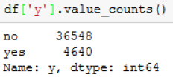
DATA
41188 records with 21 features
Data was inspected and cleaned since it was from UCI – ML Repo.
Class Imbalance –
Business problems in financial, banking and healthcare industries often have datasets that are massively imbalanced.
‘upsampling’ and ‘downsampling’ to address class imbalance

Slide 5
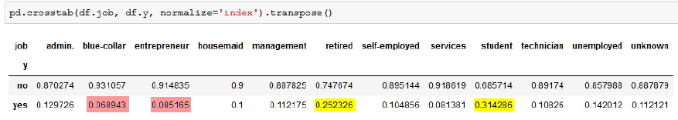
EDA
‘job’ vs ‘outcome’
Interpretation: At class-level, ‘blue-collar’ and ‘entrepreneur’ (6% and 8%) had the lowest positive response rate while retired and students had high positive response rate (25% and 31%).
This means that ‘admin’ and ‘blue-collar’ jobs were contacted frequently than any other job. However, the highest positive response rate, is among ‘retired’ and ‘student’, rather not ‘blue-collar’ and ‘entrepreneur’.

Slide 6
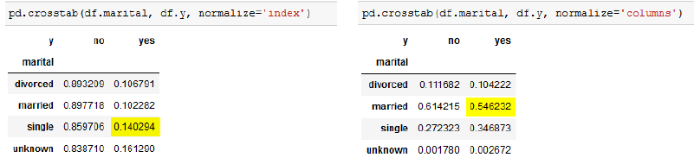
EDA
‘marital’ vs ‘outcome’
Interpretation: At class-level, 'unknown' has the highest positive response rate. At category-level, with 55% 'married' contributed the highest percentage of positive response rate.

Slide 7
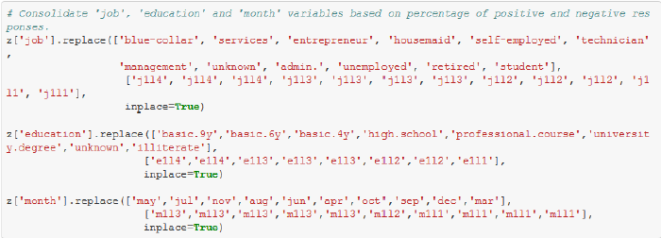
FEATURE ENGINEERING
Consolidate category classes: consolidate category classes into various levels based on the percentages of ‘yes’ class.

Slide 8

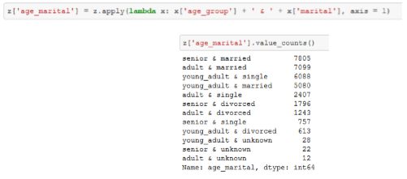
FEATURE ENGINEERING
Binning the age: Given the data is highly imbalanced, 'age' is categorised into bins based using 'qcut' rather than 'cut’
Merging 'marital' and 'age' variable

Slide 9
FEATURE ENGINEERING
Treating Outliers:
1. Applying Upper & Lower bounds to 'duration' and 'employees'
2. Applying 90 percentiles & 5 percentiles for the extreme outliers
3. Apply Logarithmic transformations to invalid outliers
Ready for Machine Learning
1. Standardization and Normalization
2. Upsampling and Downsampling
3. Dummy Variables

Slide 10
MACHINE LEARNING
Random Forests with untransformed data (Base Model)
Accuracy – 0.912, Precision – 0.44, Recall – 0.67, F1 – 0.53, AUC - 518
Randomized Search CV
Bootstrap – False, max_depth – 110, max_features – 0.2, min_samples_leaf – 5, min_samples_split – 5, n_estimators - 800
Grid Search CV
Bootstrap – False, max_depth – 110, max_features – 3, min_samples_leaf – 3, min_samples_split – 8, n_estimators - 100

Slide 11
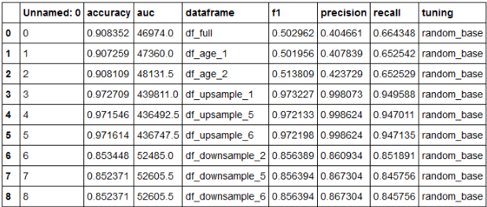
MACHINE LEARNING
Random Search on Base Model

Slide 12
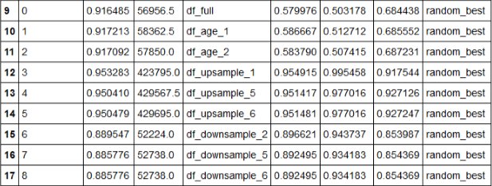
MACHINE LEARNING
Random Forest with best parameters found by random search

Slide 13
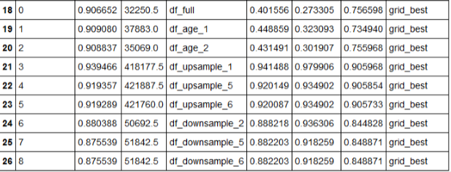
MACHINE LEARNING
Random Forest with best parameters found by grid search

Slide 14
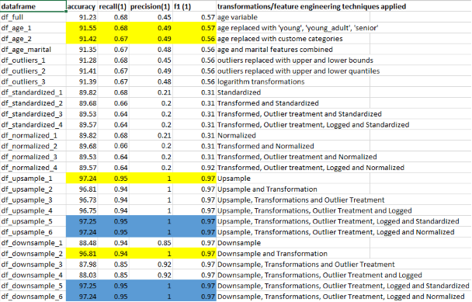
BEST MODEL
df_age_2 is the model that yields a better results on the test data.
Other models are not chosen (upsample and downsample) considering the weights each classes are given when the data is either upsampled/downsampled.

Slide 15
POTENTIAL NEXT STEPS
Potential Datasets: The data provided could actually be considered very rich in terms of predicting the client’s behavior for a given campaign. However, given additional data pertaining to client’s financial spending such as income disposal, large credit purchases, demographic of the client

